Slide 1

IoT home energy prediction
Data-driven modeling of Internet of Things
Steven Quitugua, Jake Setter, Steve Thudium

Slide 2
This presentation can be downloaded
URL = https://github.com/squitugua5821/Final_Project.git

Slide 3
Connected appliances
Smart home security systems
Autonomous farming equipment
Wearable health monitors
Smart factory equipment
Wireless inventory trackers
Ultra–high speed wireless internet
Biometric cybersecurity scanners
Shipping container and logistics tracking
Autonomous electrical and mechanical devices sharing data on the Internet

Slide 4

Use case
A home has an IoT network to collect sensor measurements, which include:
Temperature and humidity readings from sensors in multiple rooms throughout the house
Current weather at the local airport
Measurements every 10 minutes
Can this data be used to predict energy usage?
If so, how … and how well?

Slide 5
Problem statement
Analyze the available data for predictive value
Train and evaluate multiple models with actual data.
Select the linear or non-linear regression model that most accurately predicts home energy usage

Slide 6
Dataset features
Date
date – date and time
Energy usage
Appliances – total appliance energy expenditure (Watt–hours)
lights – total light energy expenditure (Watt–hours)
Room temperature (Celsius), humidity (%)
T1 – kitchen
RH_1 – kitchen
T2 – living room
RH_2 – living room
T3 – laundry
RH_3 – laundry
T4 – office
RH_4 – office
T5 – bathroom
RH_5 – bathroom
T6 – outside
RH_6 –outside
T7 – ironing room
RH_7 – ironing room
T8 – teenager room
RH_8 -- teenager room
T9 – parent’s room
RH_9 – parent’s room
Chievres airport weather station
To – temperature (Celsius)
Pressure (mm Hg)
RH_out – humidity (%)
Wind speed (m/s)
Visibility (km)
Tdewpoint (Â°C)

Slide 7

Prediction targets
Appliance -- total appliance energy usage during a 10-minute interval
Lights -- total lighting energy usage during a 10-minute interval

Slide 8

Workflow Left to right and down
Import the dataset
Evaluate and create new features
Explore and analyze data
Visualize energy usage
Identify positive - negative correlation features
Run Recursive Feature Elimination
Cull features & add dummy variables
Encode features and impute missing data
Evaluate models

Slide 9
Import the dataset
The dataset includes data for a particular home.
The dataset comes from the “UCI Machine Learning Repository.” The specific repository is the “Appliances energy prediction Data Set.”
The data is directly downloaded into the Python notebook from https://archive.ics.uci.edu/ml/machine-learning-databases/00374/energydata_complete.csv
The dataset is also kept in reserve locally as “./energydata_complete.csv”

Slide 10
Encode features and impute missing data
Encode date string
The date comes as a string, like “1/11/2016 5:00:00 PM.“
The date string is converted to the datetime format, with any seconds removed.
”2016-01-11 17:00”
A datetime object simplifies parsing
Rename features with meaning
Meaningful names mean meaningful visualizations
E.g., change “T1” to “T_kitchen”; “RH_1” to “RH_kitchen”
Delete duplicate records
No imputation is needed. Null value counts and row counts viz-a-viz the time range indicate no data is missing

Slide 11
Evaluate and create new features
Derive the following features from the datetime object
Day
Day_of_week
Time
Hour
NSM - number of seconds since last midnight
Sort by Day and Time

Slide 12
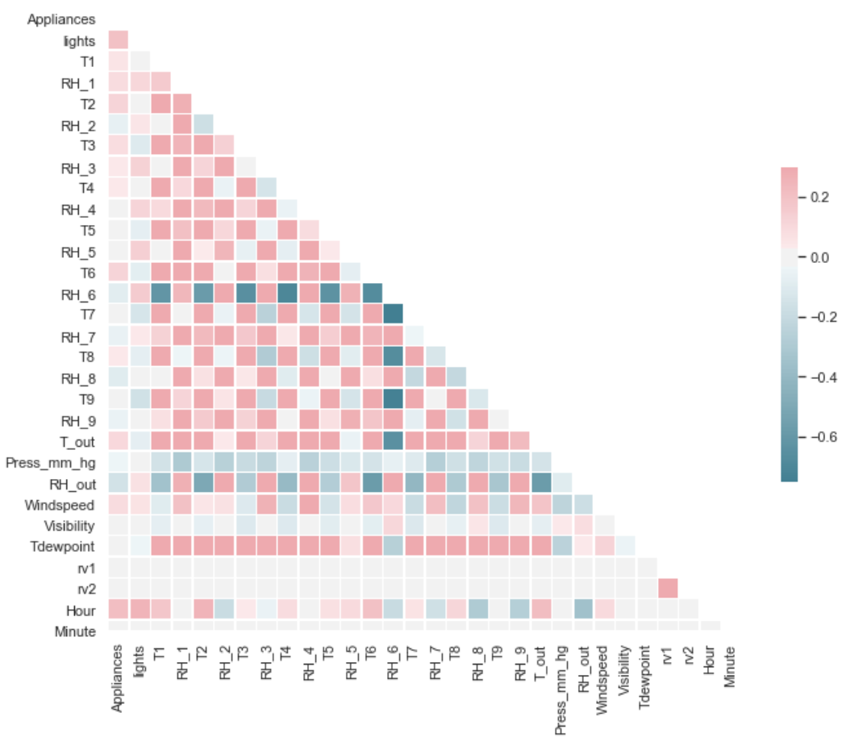
Exploratory data analysis 1
Correlation matrix heatmap – 6-month aggregate.
Appliances and lights are weakly correlated with all features
Features are weakly correlated, except for the outside humidity, RH_6, and temperature
Dark red is weak positive correlation (+0.2)
Dark blue is strong negative correlation (-0.7)

Slide 13
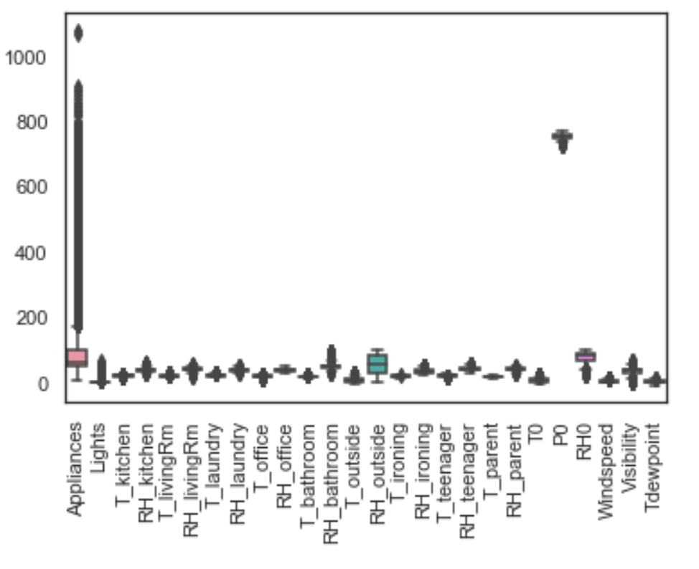
Exploratory data analysis 2
The range of values for Appliances is wide and highly variable
The range of values for Lights is not wide, but is highly variable
The range of all other features is relatively narrow
The mean of airport pressure (P0) is large

Slide 14
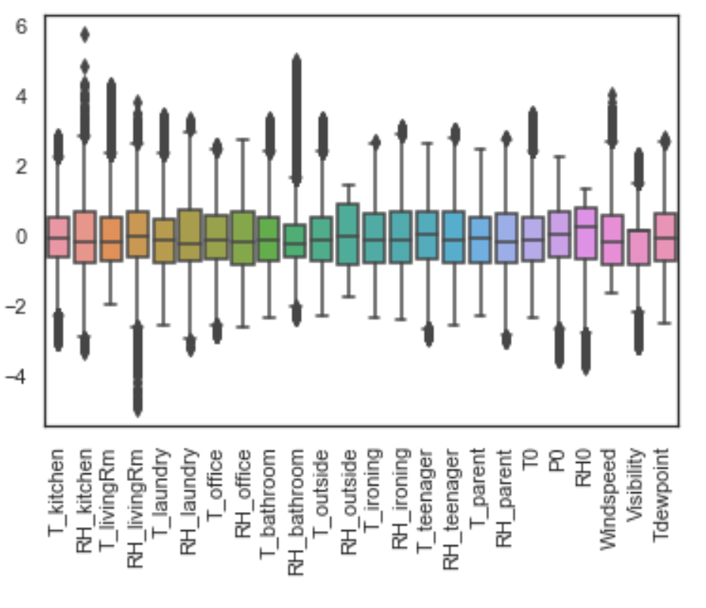
Exploratory data analysis 3
Appliance and lighting is omitted.
The above boxplots are normalized – subtract mean, divide by variance.
There are outliers in the dataset
Some room measurements are skewed for example room humidity in the bathroom is skewed right most likely due to the use of the shower and RH in the kitchen is skewed right possibly from increased humidity when cooking

Slide 15
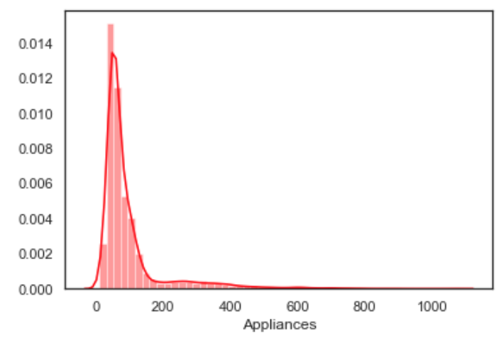
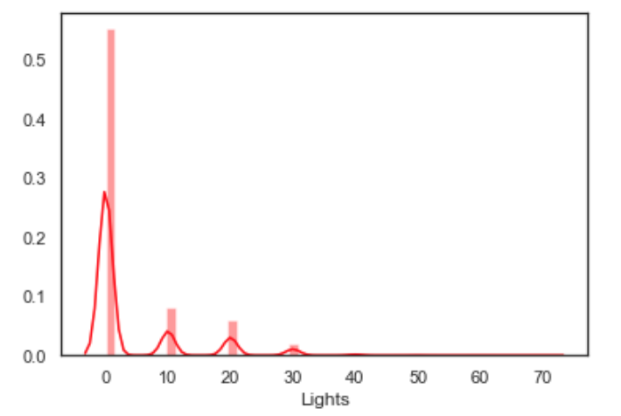
Exploratory data analysis 4
Distribution of appliance and lighting energy usage
Most of the appliance energy (in a 10-minute interval) is between 10 and 180 Watt-hours, with occasional peak usage
Most of the lighting energy is zero, since lights are typically off from midnight to sunset
No obvious outliers need to be replaced (nothing extraordinary)

Slide 16
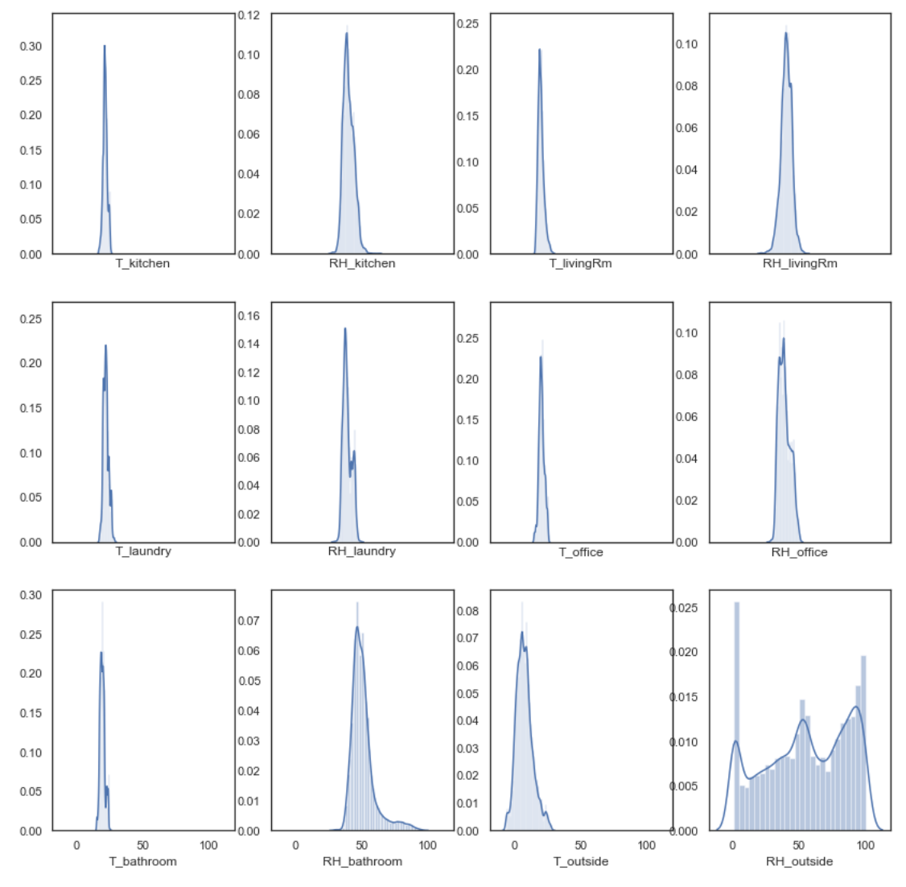
Exploratory data analysis 5
Distribution of 12 input features
Indoor and outdoor temperature and humidity
Most data is moderate, except the outside humidity, which varies randomly form 0 to 100%
No obvious outliers need to be replaced

Slide 17
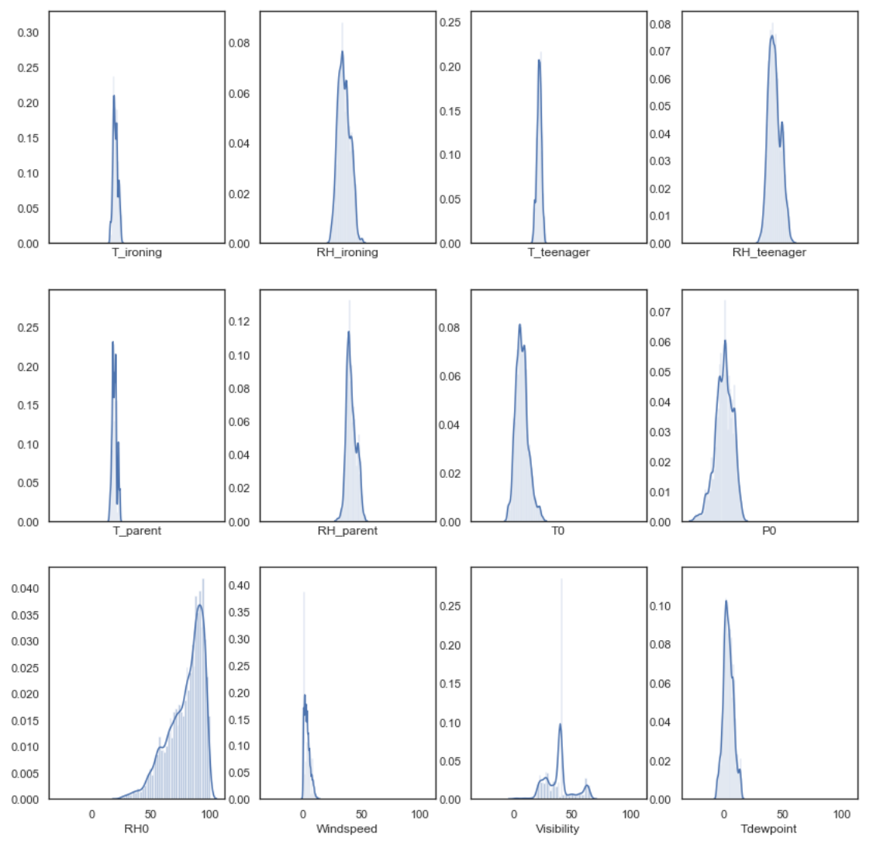
Exploratory data analysis 6
Another distribution of 12 input features
Indoor temperature and humidity and airport weather
Most data is moderate, except the airport humidity, which is variable with the peak at 80%, and falling rapidly
No obvious outliers need to be replaced

Slide 18
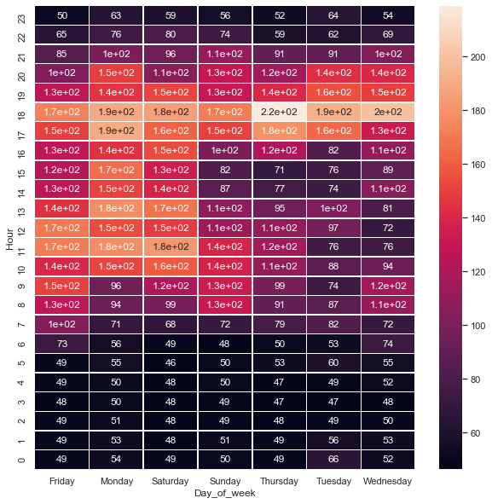
Appliance energy usage visualization
Peak appliance usage is found
on Thursday at 1800 to 1900
(6pm to 7pm) at 220 kW-hour.
Least amount of usage as
expected, is during the 10pm
to 6am time frame.
Probable factors: AC unit,
cooking, people getting home
from work, and entertainment
appliances.

Slide 19
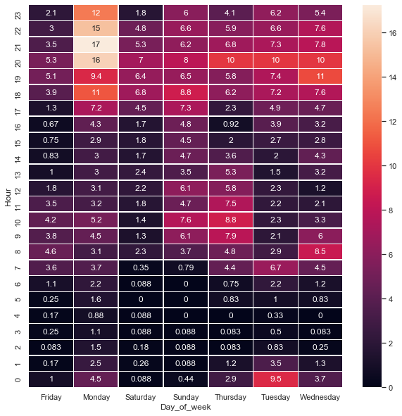
Lighting energy usage visualization
Peak light usage is found on
Monday from 9pm to 11pm at
15-17 kW-hour.
Least amount of usage as
expected, is during the midnight
to 6am time frame.
Probable factors: people getting
home from work and getting ready
for the next day.

Slide 20
Cull features &dummy variables
Remove the following features, which are not be used in the ML models
date - replaced with Day_of_week, NSM
rv1 - in original dataset, but not used
rv2 - in original dataset, but not used
Date - not needed for ML prediction, which will use Day_of_week, NSM
Time - not needed for ML prediction, which will use Day_of_week, NSM
Hour - not needed for ML prediction, which will use Day_of_week, NSM
Add dummy variables to replace the single feature Day_of_week. Instead 7 new features are added, like Day_of_week_Sunday

Slide 21
Run Recursive Feature Elimination
Eliminating non-predictive features speeds up the prediction - don't waste CPU cycles on worthless features or risk overfitting, which is being bound too closely to a “particular” set of data
A Scikit-Learn function, RFE, ranks features for predictive value. The 5 most predictive values are used
The ranking for appliances and lighting is completely different
Took a computer-hour, using only 5% (1000) records, randomly selected
The literature suggests that an alternative, Boruta, provides equivalent results as RFE, but is less CPU intensive http://www.socr.umich.edu/people/dinov/courses/DSPA_notes/16_FeatureSelection.html

Slide 22
Appliances & Lighting feature ranking
Feature | Appliance rank | Lighting rank |  | Feature | Appliance rank | Lighting rank |  | Feature | Appliance rank | Lighting rank
T_kitchen | 1 | 8 |  | RH_outside | 26 | 23 |  | Visibility | 23 | 15
RH_kitchen | 2 | 9 |  | T_ironing | 4 | 2 |  | Tdewpoint | 18 | 20
T_livingRm | 7 | 4 |  | RH_ironing | 25 | 14 |  | Day_of_week_Friday | 28 | 28
RH_livingRm | 5 | 13 |  | T_teenager | 1 | 3 |  | Day_of_week_Monday | 21 | 24
T_laundry | 13 | 7 |  | RH_teenager | 3 | 6 |  | Day_of_week_Saturday | 6 | 15
RH_laundry | 11 | 17 |  | T_parent | 1 | 1 |  | Day_of_week_Sunday | 1 | 10
T_office | 8 | 1 |  | RH_parent | 14 | 26 |  | Day_of_week_Thursday | 9 | 12
RH_office | 20 | 5 |  | T0 | 22 | 22 |  | Day_of_week_Tuesday | 17 | 1
T_bathroom | 15 | 1 |  | P0 | 27 | 27 |  | Day_of_week_Wednesday | 1 | 1
RH_bathroom | 24 | 21 |  | RH0 | 19 | 16 |  | NSM | 10 | 19
T_outside | 16 | 18 |  | Windspeed | 12 | 11

Slide 23
Identify positive - negative correlation features
Linear regression models performed poorly when using features that are both positively and negatively correlated to the target (app/lights)
Split the dataset into one with positive correlation and one with negative correlation.
A total of four datasets are created, two for appliances and two for lighting, since the positive - negative mix is different for those two targets.
Test this hypothesis during model evaluation

Slide 24
Evaluate models through iteration
Run
Target
Scalar
Model
Evaluate
StandardScaler
MinMaxScaler’
PowerTransformer
RobustScaler
fit scalar
split training & test
train
Evaluate r2 & MSE
Export r2 & MSE
full feature set
top 5 RFE ranked for Appliances
top 5 RFE ranked for Lights'
positive correlation w/
Appliances
positive correlation w/
Lights
negative correlation w/
Appliances
negative correlation w/
Lights
Appliances
Lights
LinearRegression
Lasso
Ridge
ElasticNet
SVR
RandomForestRegressor

Slide 25
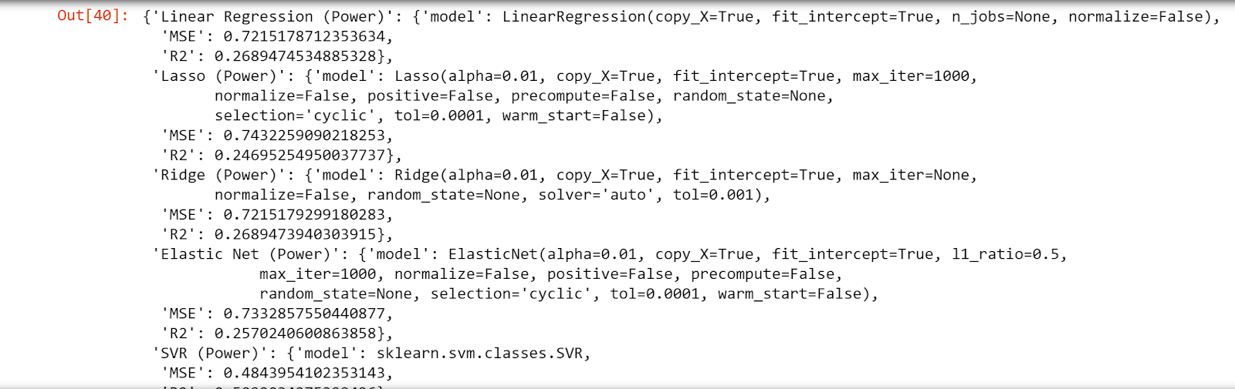
Easy ML Class
Allows a developer to access machine learning models by simply giving known inputs and outputs.
Iterate through combinations of scalars and machine learning models to identify the best model for any ml problem.
Output dictionary object with each model ready to use for end user
Below is an example of the dictionary object output:

Slide 26
EasyML pseudocode
class Easy_ML(object):
def __init__(self, X, y):
#Initialize object pass in inputs and outputs and results dictionary
def find_best_model():
def transform_selection(transform_type):
this function is used in the find_best_model and takes an input of a transformation type and outputs the corresponding transformer object
# reshape X and y
#split X and y
#iterate through all the combinations of scalars and models and add r2, MSE, and models to results dictionary
#return results dictionary

Slide 27
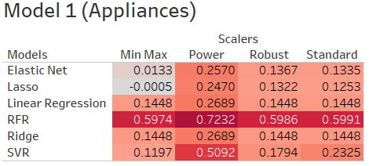
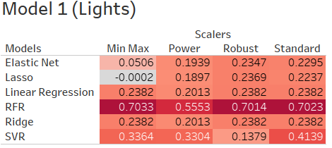
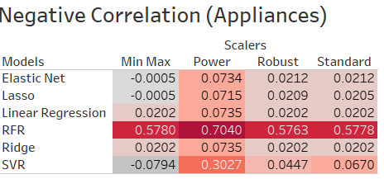
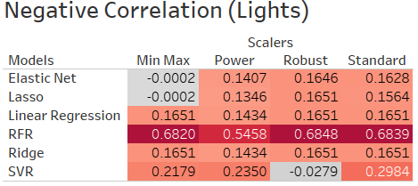
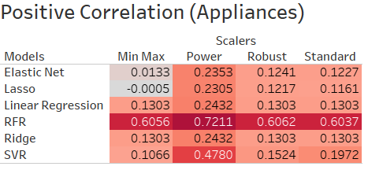
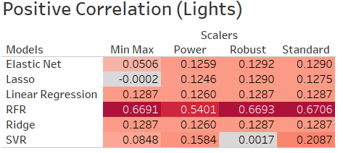
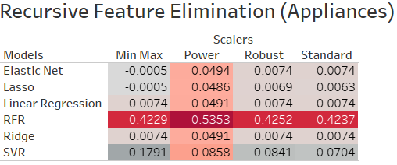
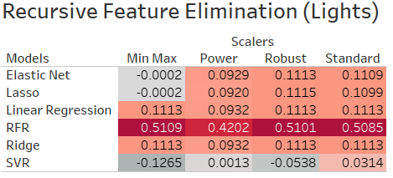
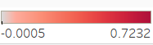
Results

